Slide 1
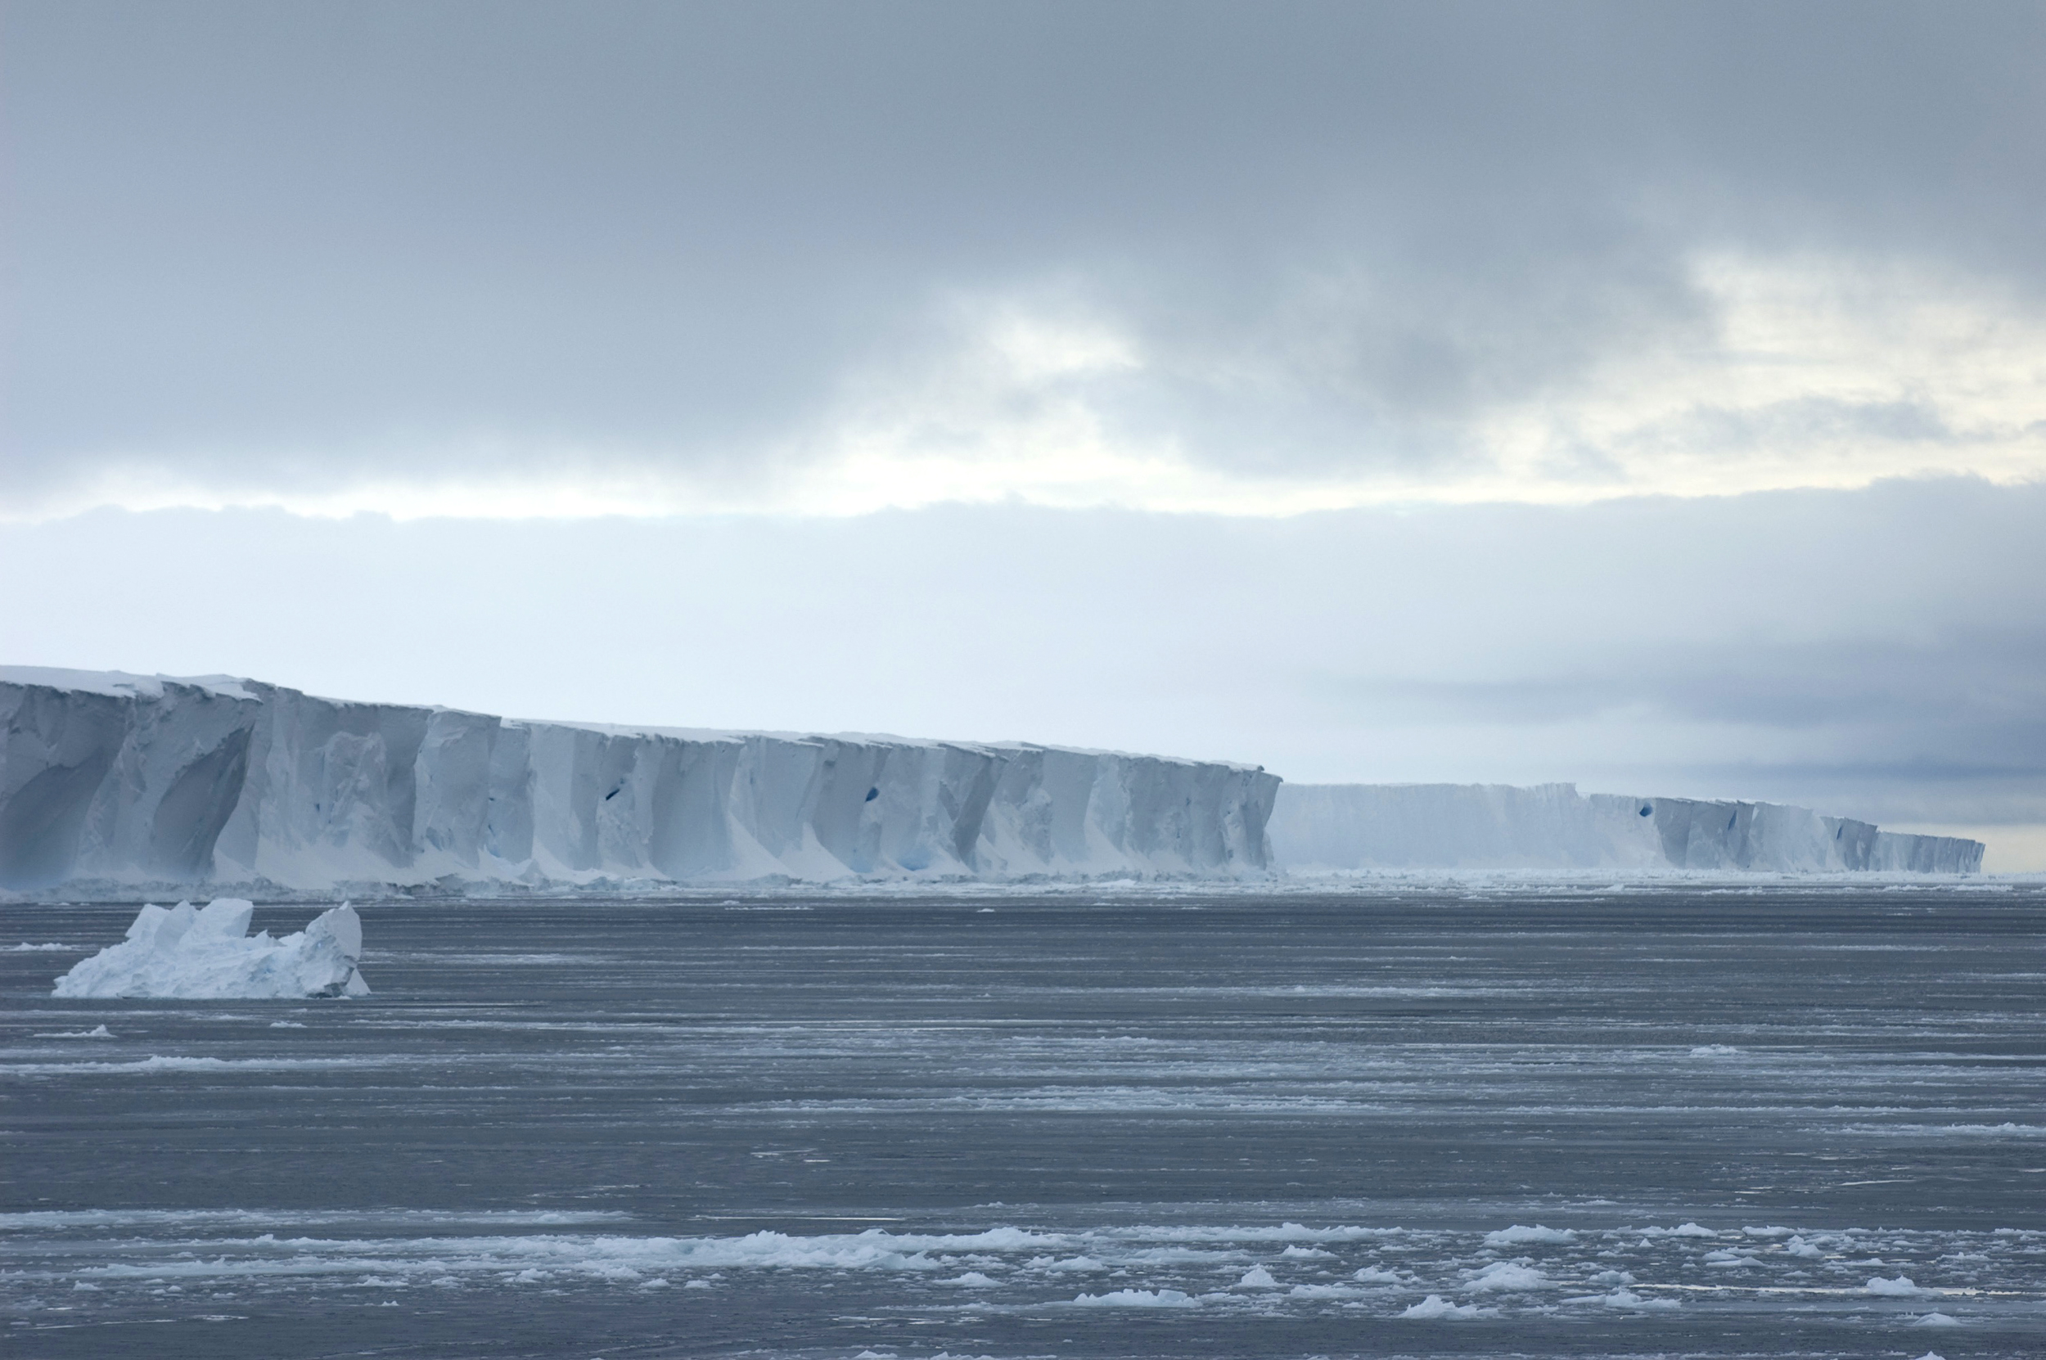


Historical and future projected warming of Antarctic Shelf Bottom Water in CMIP6 models
Ariaan Purich and Matt England
10 June 2021

Slide 2
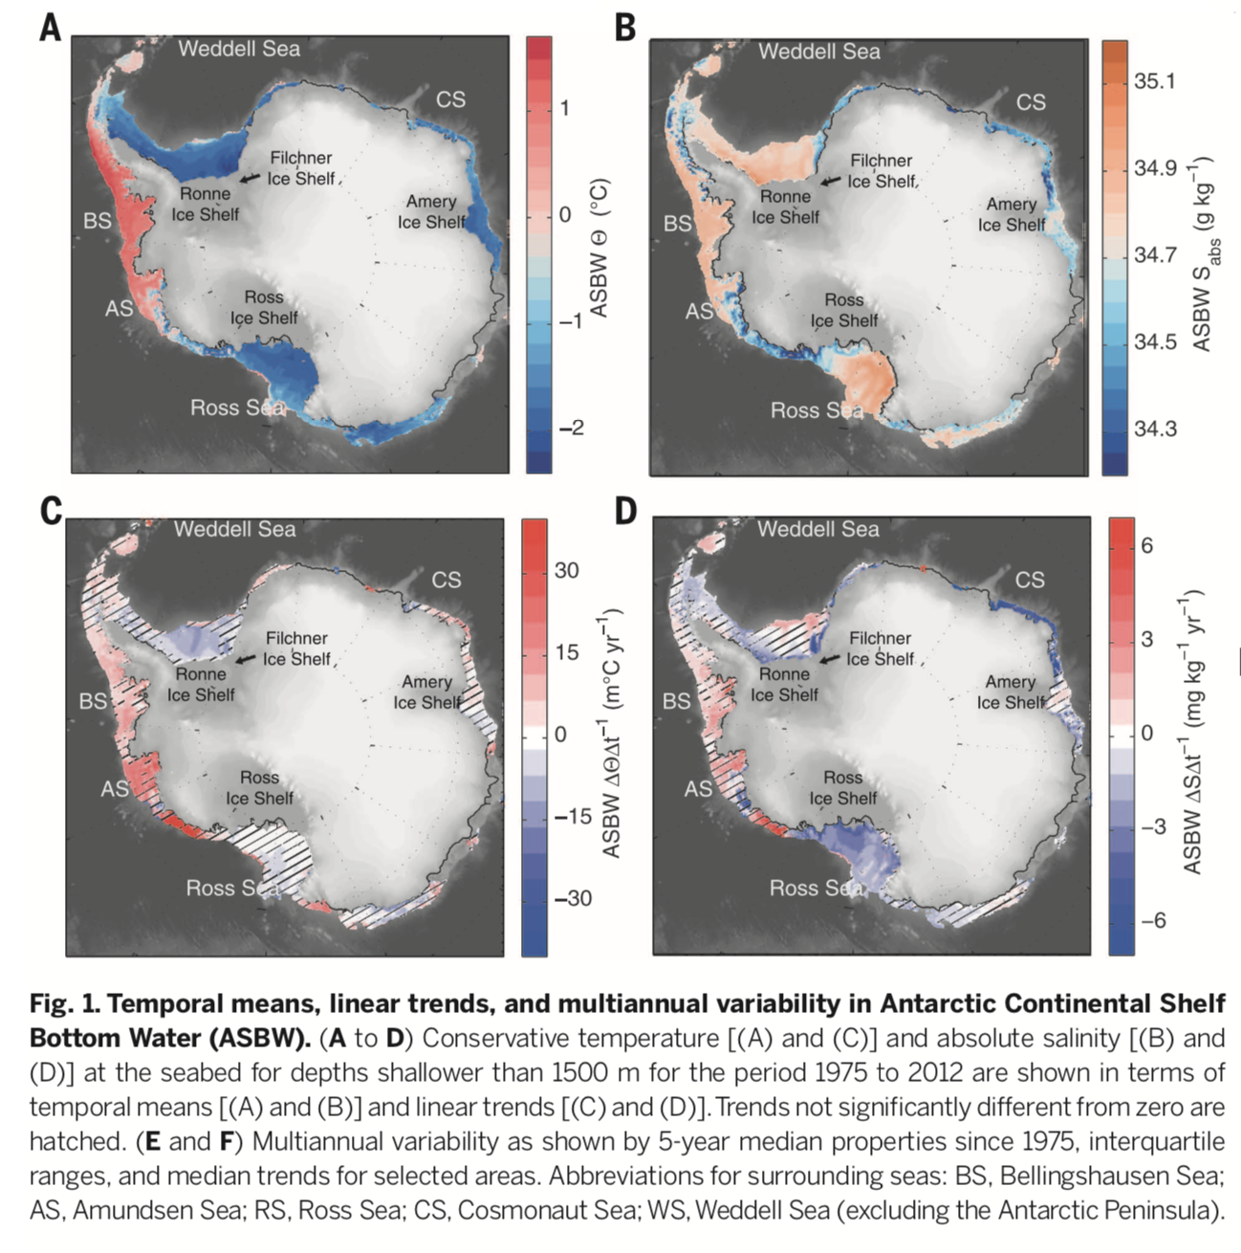




Data and methods
Mean-state temperature
22 CMIP6 models with historical, SSP245 and SSP585 data available 1950-2100
Including ACCESS-CM2 and ACCESS-ESM1.5
Temperature, salinity and surface variables
ASBW T in grid cell above seabed, for depths < 1500 m
Historical mean and trends over 1975-2012
Future trends over full SSP period 2015-2100
Zonal means show differences for WOA18 comparison
Temperature trends
Schmidtko et al. (2014)

Slide 3
Zonal temperature
Observed mean
CMIP6 historical mean
On shelf
Off shelf
Historical mean
Latitude shifted relative to the 1000-m isobath at each longitude, then averaged zonally
CMIP6 MMM resembles observations, but is biased warm
Historical changes are modest
Both future scenarios share the same warming structure, the magnitude of warming increasing considerably in SSP585
Observed change
CMIP6 historical change
SSP585 change
SSP245 change
SSP585 change
Notes:
I first present mean-state and decadal changes in zonal temperature.
In contrast to a conventional zonal-mean plot, here latitude is shifted relative to the 1000-m isobath at each longitude, before averaging zonally.
This allows the Antarctic shelf to be clearly seen in adjusted latitudes south of the 1000 m isobath, and the open ocean in adjusted latitudes north of the 1000 m isobath.

Slide 4
Shelf temperature
Observed mean
CMIP6 historical mean
Historical mean
CMIP6 MMM is too warm across all shelves, and particularly at the shelf edge
Observed trends show cooling in the western Ross and Weddell Seas, and strong warming in the Amundsen-Bellingshausen Seas
CMIP6 MMM historical trends show weak broad scale warming
Strong future warming, magnitude increases in SSP585
Observed trend
CMIP6 historical trend
SSP585 trend
SSP245 trend
SSP585 trend

Slide 5
Inter-model relationships

Slide 6
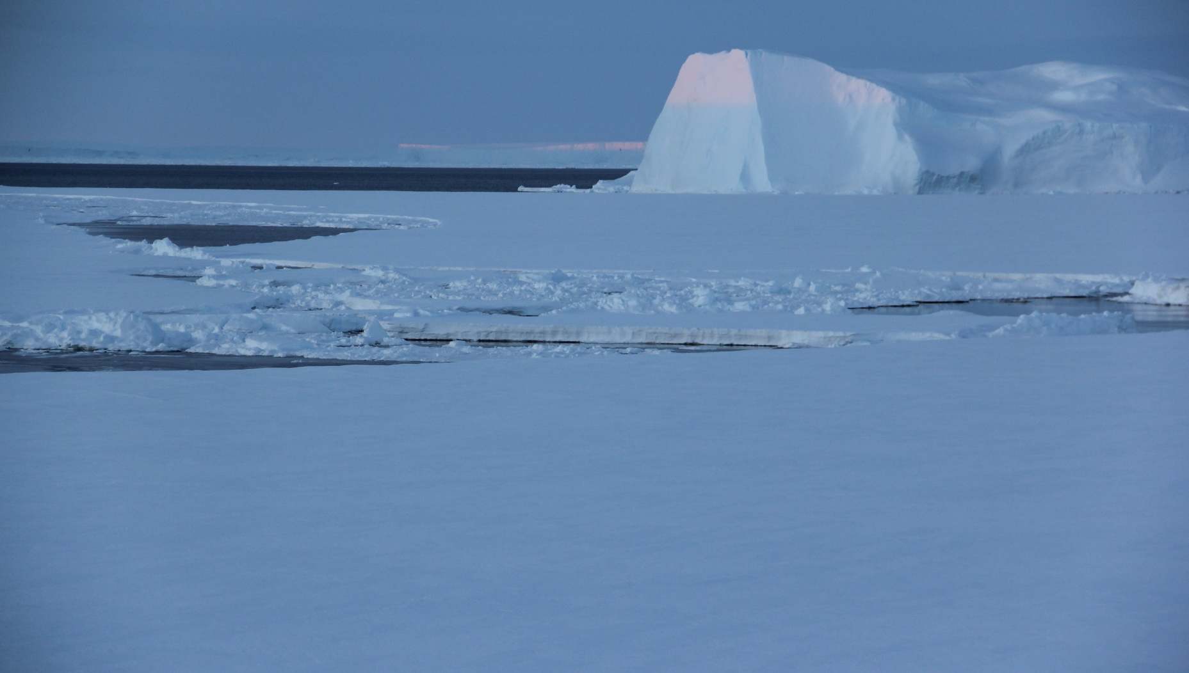
Summary
The CMIP6 multi-model mean captures the observed mean-state Antarctic Shelf Bottom Water pattern but is overall biased warm
An average shelf water warming of 0.36°C under SSP245 and 0.62°C under SSP585 by 2100 is projected
Future shelf water warming in CMIP6 models is linked with positive SAM trends and CDW warming trends
a.purich@unsw.edu.au
Purich, A. and M. H. England (2021), Historical and projected Antarctic Shelf Bottom Water in CMIP6 models, GRL, doi:10.1029/2021GL092752

